Slide 1

Lecture 40 GREEN CLOUD COMPUTING

Slide 2
Definition of Green cloud computing.
Green cloud computing refers to the potential environmental benefits cloud-based services can offer society. The term combines two words: green, which means environmentally friendly, and cloud computing, which is the delivery of IT services over the internet.
OR
Green cloud computing is a coined term that means making the practices and approaches of using technological advances like computing and other IT resources sustainable for potential environmental benefits.
OR
Green cloud computing allows users to utilize the benefits of cloud storage while decreasing its adverse effects on the environment, ultimately affecting human well-being. It includes the following practices:

Slide 3
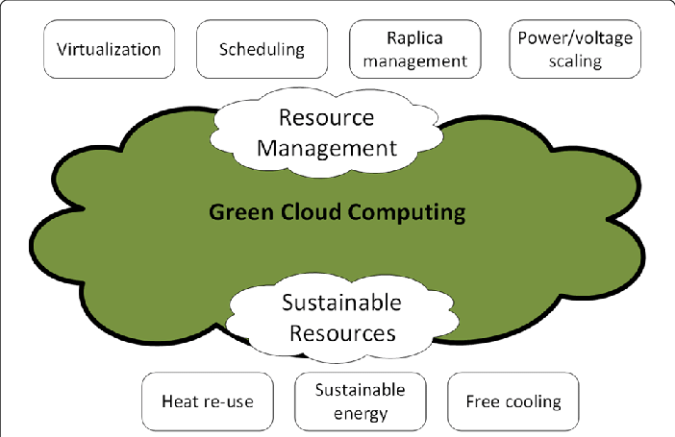
Diagram of green cloud computing – suitable way to use cloud .

Slide 4
Benefits or advantages of Green Computing
Following are the benefits or advantages of Green Computing: ➨Telecommuting techniques help in increases profit margins, increases worker satisfaction and reduces greenhouse gas emissions (by avoiding travelling requirements of employees/customers).
➨Virtualization of IT helps in running two or more computer systems on single set of physical hardware. This reduces operating costs for energy and cooling. This ultimately helps in saving money.
➨It reduces usage of paper and other consumables in IT industry. ➨Green manufacturing makes use of bamboo for computers and peripherals. Moreover computers are constructed using recyclable plastics. Hence it will have less impact on the environment.
➨It minimizes equipment disposal requirements by adopting reuse, refurbish and recycle methods.

Slide 5
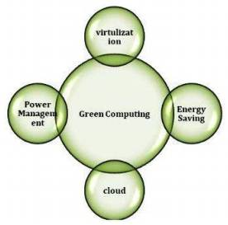
Advantages of green cloud computing.
Advantages

Slide 6
Drawbacks or disadvantages of Green Computing
Following are the drawbacks or disadvantages of Green Computing:
➨Implementation of green computing requires higher start up cost. ➨The green computing systems sacrifies performance to improve battery life. ➨Adoption and success of green computing system requires years of efforts by consumers and organizations. ➨It is not available for everyone at affordable cost.

Slide 7
Green cloud computing
With Green cloud computing, world is looking forward to higher energy efficient mechanism, managed security services, cloud security solutions at one place by offering equivalent and cloud management platform benefits with enormous environmental impact!
Cloud computing, is an important facet for any IT operations of any organization, continuous attempts have been made to make it- much “greener”.
“The green cloud”- certainly a superior marketing label, is employed by organizations for handling environmental considerations and concerns effectively. With contribution, towards the critical business operational goals and reduced costs across the servers, green cloud is most environment friendly initiative.

Slide 8
Factors for Green Computing
Product longevity
Gartner maintains that the PC manufacturing process accounts for 70% of the natural resources used in the life cycle of a PC. More recently, Fujitsu released a Life Cycle Assessment (LCA) of a desktop that show that manufacturing and end of life accounts for the majority of this desktop's ecological footprint.
Data center design
Energy efficient data center design should address all of the energy use aspects included in a data center: from the IT equipment to the HVAC equipment to the actual location, configuration and construction of the building.

Slide 9
FACTORS OF GREEN COMPUTING
Resource allocation
Algorithms can also be used to route data to data centers where electricity is less expensive. .Larger server centers are sometimes located where energy and land are inexpensive and readily available. Local availability of renewable energy, climate that allows outside air to be used for cooling, or locating them where the heat they produce may be used for other purposes could be factors in green siting decisions.
Power management
The Advanced Configuration and Power Interface (ACPI), an open industry standard, allows an operating system to directly control the power-saving aspects of its underlying hardware. This allows a system to automatically turn off components such as monitors and hard drives after set periods of inactivity. In addition, a system may hibernate, when most components (including the CPU and the system RAM) are turned off. ACPI is a successor to an earlier Intel-Microsoft standard called Advanced Power Management

Slide 10
Materials recycling
Recycling computing equipment can keep harmful materials such as lead, mercury, and hexavalent chromium out of landfills, and can also replace equipment that otherwise would need to be manufactured, saving further be given for recycling, and they typically sign a non-disclosure agreement.
Algorithmic efficiency
The efficiency of algorithms has an impact on the amount of computer resources required for any given computing function and there are many efficiency trade-offs in writing programs. Algorithm changes, such as switching from a slow (e.g. linear) search algorithm to a fast (e.g. hashed or indexed) search algorithm can reduce resource usage for a given task from substantial to close to zero.

Slide 11
THANKS

